Slide 1
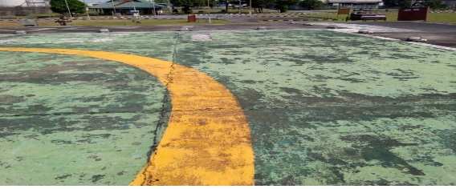
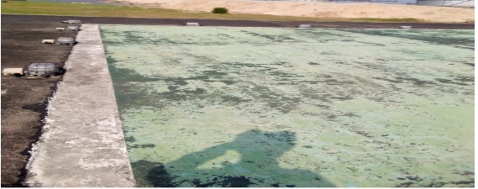
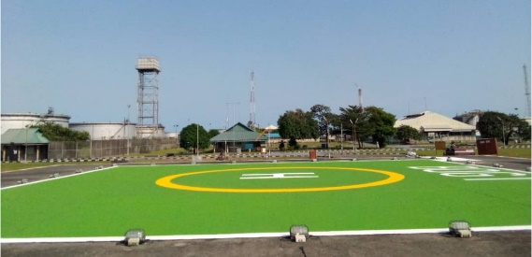
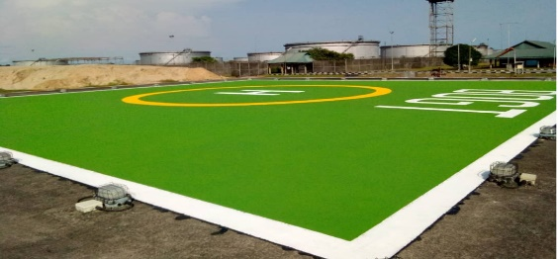
Bonny PU: Showcase Outstanding Delivery
Painting of BOGT helipad and regulatory marking .
Bonny terminal helipad surface suffered paints and marking failure as a result of usage and impact of adverse weather condition. Its proximity to bonny river exacerbate the landing path defects. Effort to inaugurate an execution contract was not successful.
Solution:
The terminal mechanical team carried out activity assessment and scoping.
Seek support from Shell Aviation SME on regulatory standards and acceptable marking.
Secured support from Asset leadership to progress execution.
Procured specific paints and execute tasks safely inline with NCAA marking standard within budget.
Business Value:
OPEX Cost avoidance >4 Million Naira, if contracted.
Improved helipad surface standard for flight operations.
Enhanced asset integrity, availability and reliability.
Before Painting
After Painting

